Slide 1
Project 2
Bayesian Networks

Slide 2
Group Members
Chris Townsend
Shanon Clemmons

Slide 3
Bayesian Network - NODES
Asian Travel
Smoking
Tuberculosis
Lung Cancer
Bronchitis
CXRFindings
Dyspnea

Slide 4
Statistical Data
Trait | Given | Prevalence
Asian travel | - | 0.5%
Smoking | - | 19.80%
Tuberculosis | no travel | 4.11%
 | travel | 5.0%
Lung cancer | no smoking | 0.06%
 | smoking | 0.23%
Bronchitis | no smoking | 4.45%
 | smoking | 18.82%
CXRFindings | none | 23.50%
 | tuberculosis | 92.00%
 | cancer | 84.00%
 | both
Dyspnea | none | 1.50%
 | tuberculosis | 43.20%
 | cancer | 40.00%
 | bronchitis | 20.70%
 | TB/canc | 60%
 | TB/bronch | 50%
 | canc/bronch | 50%
 | all | 75%

Slide 5
Bayesian Network (TOP)
P(A)
.5
P(S)
.5
Asian Travel (A)
Smoking (S)
S | P(L | S)
T | .23
F | .06
Lung Cancer (L)
Bronchitis (B)
A | P(T | A)
T | 5
F | 4.11
Tuberculosis (T)
S | P(B | S)
T | 18.82
F | 4.45

Slide 6
Bayesian Network (BOTTOM)
Tuberculosis (T)
Lung Cancer
(L)
Bronchitis
(B)
Dyspnea
(D)
CXRFindings
(X)
T | L | B | P(D | T, L, B)
F | F | F | 1.5
F | F | T | 20.7
F | T | F | 40
F | T | T | 50
T | F | F | 43.2
T | F | T | 50
T | T | F | 60
T | T | T | 75
T | L | P(X | T, L)
F | F | 23.5
F | T | 84
T | F | 92
T | T | 95

Slide 7
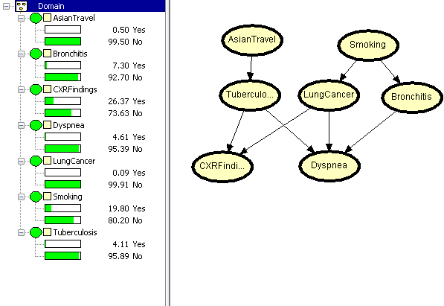
HUGIN LITE

Slide 8
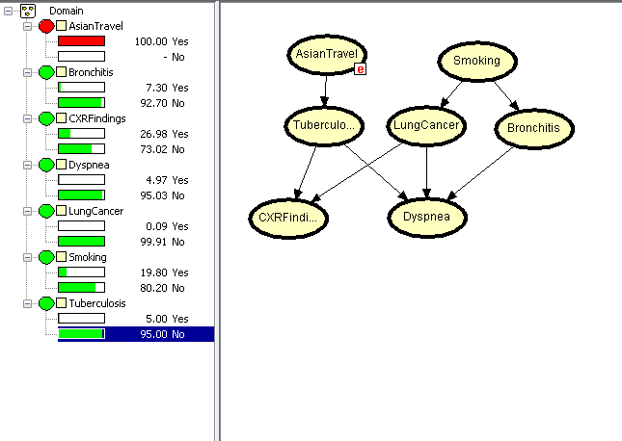
Asian Travel

Slide 9
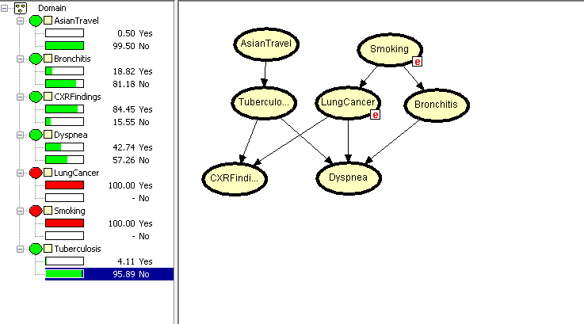
Smoker With Lung Cancer

Slide 10
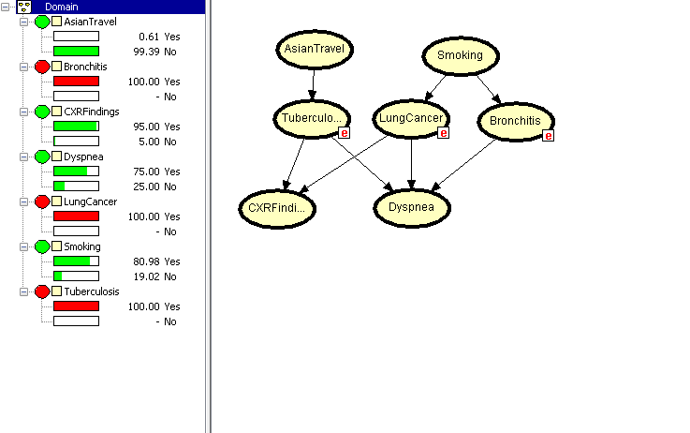
Tuberculosis, Lung Cancer & Bronchitis

Slide 11
Part 2

Slide 12
Tuberculosis And Lung Cancer can cause Dyspnea with equal likelihood

Slide 13
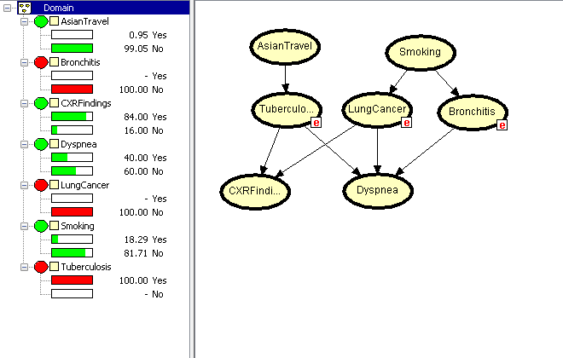
Tuberculosis

Slide 14
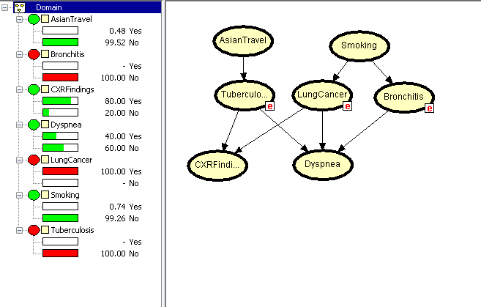
Lung Cancer

Slide 15
A positive chest X-ray is equally likely given either tuberculosis or lung cancer

Slide 16
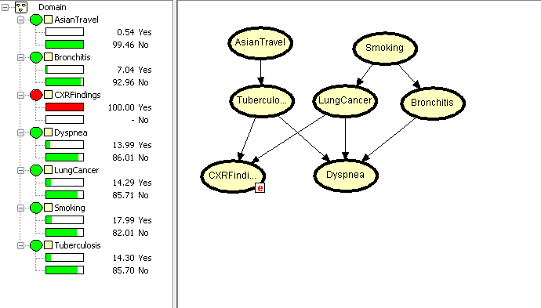
Chest Ray Finding

